Slide 1
Motion along a straight line

Slide 2
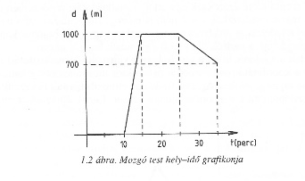
Graph
Position-time graph

Slide 3
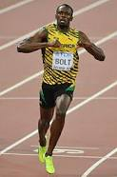
Average speed
Usain Bolt
100 m sprint
WR: 9.58 s
100 m – 10 s
1 s -10 m
Average

Slide 4

Average speed
Average speed = $\frac{total distance covered}{time taken}$
$v_{ave}$= $\frac{s_{t}}{t_{t}}$
Unit: $\frac{m}{s}$, $\frac{km}{h}$
Conversion factor: 3.6
$\frac{km}{h}$ $→\frac{m}{s}$ : divide by 3.6
$\frac{m}{s}→$ $\frac{km}{h}$ $∙multiply by 3.6$

Slide 5
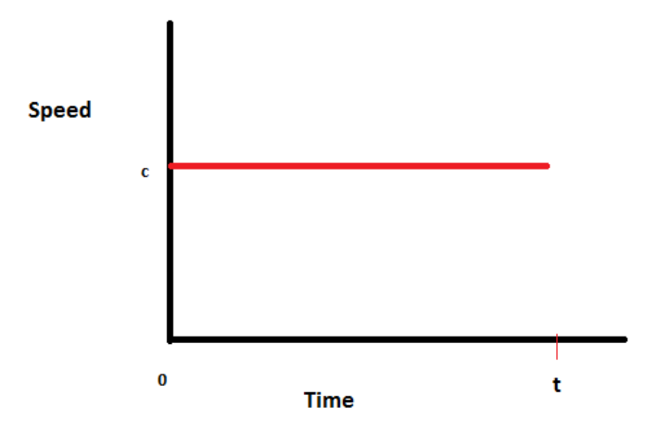
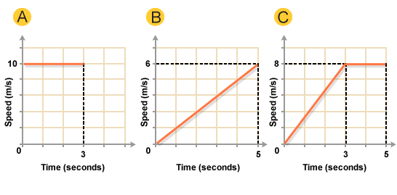
Speed-time graph
It represents the speed with the respect to the time

Slide 6
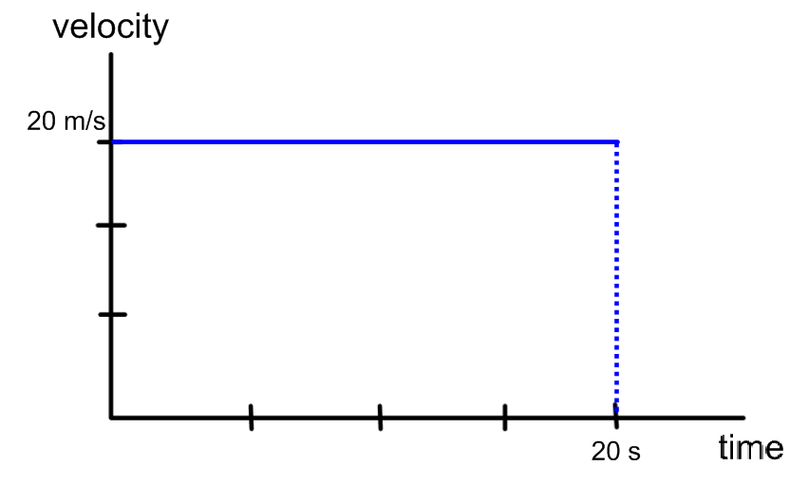
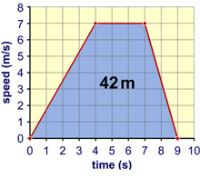
Speed-time graph
The area under the speed time graph line represents the distance the objects travel.

Slide 7
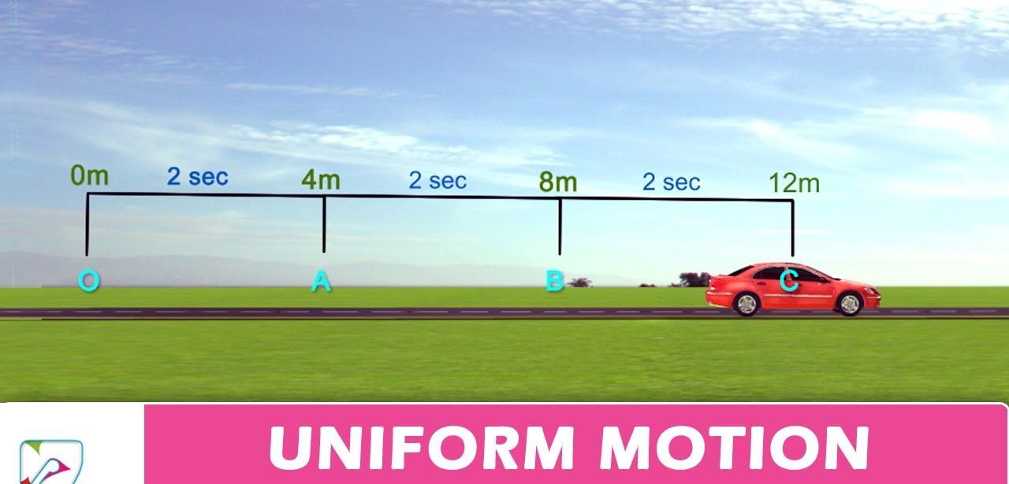
Uniform motion
The object’s speed is constant.
The object travels in one direction along a straight line
It travels equal distances in equal intervals of time

Slide 8
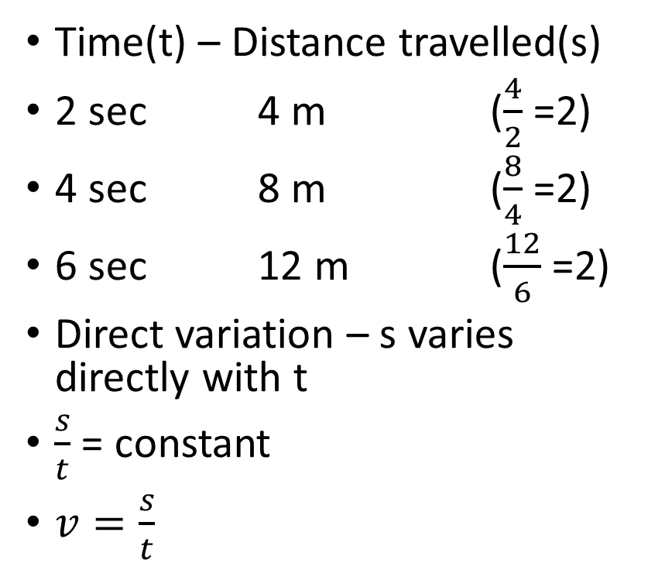
Uniform motion
Time(t) – Distance travelled(s)
2 sec 4 m ($\frac{4}{2}$ =2)
4 sec 8 m ($\frac{8}{4}$ =2)
6 sec 12 m ($\frac{12}{6}$ =2)
Direct variation – s varies directly with t
$\frac{s}{t}$ = constant
$v=\frac{s}{t}$

Slide 9
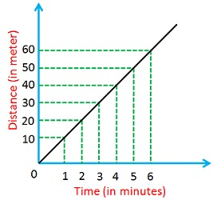
Distance-time graph
It represents the distance travelled with the respect to the time

Slide 10
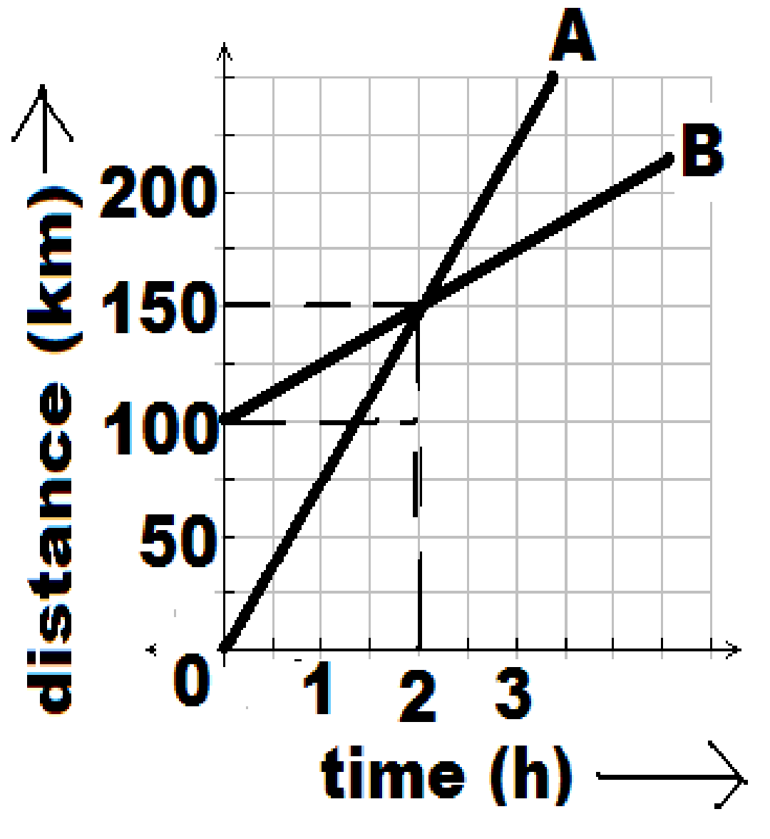
Distance-time graph
The slope of the graph is equal to the speed of the object.

Slide 11
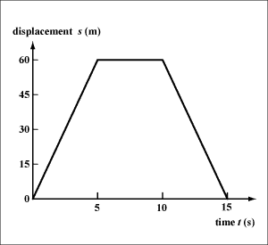
Displacement-time graph
It represents the displacement with the respect to the time
From time t=0s to t=5s, the object moves forwards.
At t= 5s it has a displacement of 60 m.
From time t=5s to t=10s it remains stationary.
From t=10s to t=15s it moves back to its starting position.

Slide 12
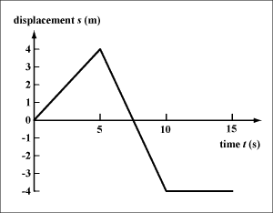
Displacement-time graph
Car during parking
From t=0s to t=5s the car moves forward its displacement will be +4m at the time of 5s.
The car moves backward passes the origin to the -4 m in the next 5 s.
The car remains at rest in the last 5s.

Slide 13
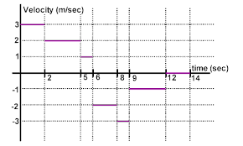
Speed-velocity
Speed
Velocity
It’s a scalar quantity, it has only magnitude
It’s a vector quantity, it has both magnitude and direction.

Slide 14

Displacement-time graph$→$ Velocity-time graph

Slide 15
Displacement-time graph$→$ Velocity-time graph

Slide 16

Displacement-time graph$→$ Distance-time graph

Slide 17
Displacement-time graph$→$ Distance-time graph

Slide 18
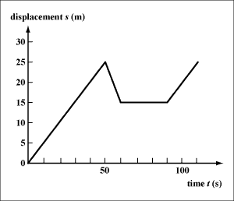
Homework
Create the
Velocity-time graph
Speed time graph!
Distance-time graph!

Slide 19
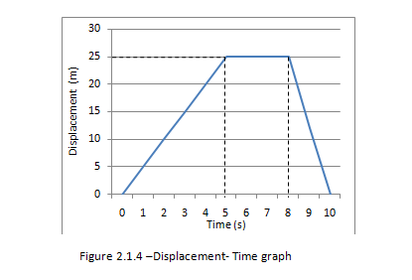
Homework
Create the
Velocity-time graph
Speed time graph!
Distance-time graph!

Slide 20
Homework
Create the
Speed-time graph!
Displacement-time graph!
Distance-time graph!

Slide 21
Instantaneous speed Instantaneous velocity
Instantaneous speed is a speed of an object at a particular moment in time
Instantaneous velocity: when you include the direction of that speed
https://www.khanacademy.org/science/physics/one-dimensional-motion#displacement-velocity-time

Slide 22
Instantaneous speed Instantaneous velocity

